Slide 1
Modeling Combinational Circuits Behavioral Design

Slide 2
always Block
As the name suggests, an always block executes always, unlike initial blocks which execute only once (at the beginning of simulation).
always blocks can contain case statements, for loops, while loops, even functions – they enable high-level behavioral modeling
The syntax is:
always @( <sensitivity list> )
begin
….
end

Slide 3
always Block Sensitivity List
The sensitivity list specifies which signals inside the always block to be updated. The items in the list may be separated by comma or or.
always @ (*) sets the sensitivity list to any values that can have an impact on outputs. ‘*’ provides a shorthand for creating complete sensitivity lists.
always @ (*) blocks are used in Combinational Logic.

Slide 4
always Block Sensitivity List
✓ always @ (B, C)
A = B & C;
✓ always @ (B or C)
A = B & C;
✓ always @ (*)
A = B & C;
X always @ (B)
A = B & C;

Slide 5
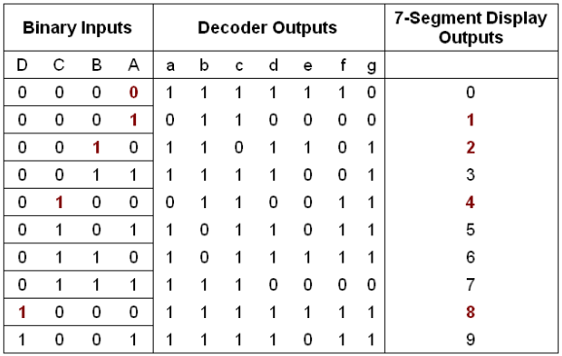
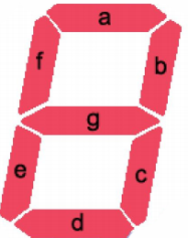
Examples BCD-7-Seg Decoder

Slide 6
BCD-7-Seg Decoder
module BCD7seg (LED, number);
output reg [1:7] LED; // LED = {a, b, c, d, e, f, g}
input [3:0] number;
always @(*) // or always @(number)
case(number)
0: LED = 7’b1111110;
1: LED = 7’b0110000;
2: LED = 7’b1101101;
3: LED = 7’b1111001;
4: LED = 7’b0110011;
5: LED = 7’b1011011;
6: LED = 7’b1011111;
7: LED = 7’b1110000;
8: LED = 7’b1111111;
9: LED = 7’b1111011;
default: LED = 7’b0000000; // necessary for avoiding latch generation
endcase
endmodule
Any assignments in an always block must assign to a reg variable

Slide 7
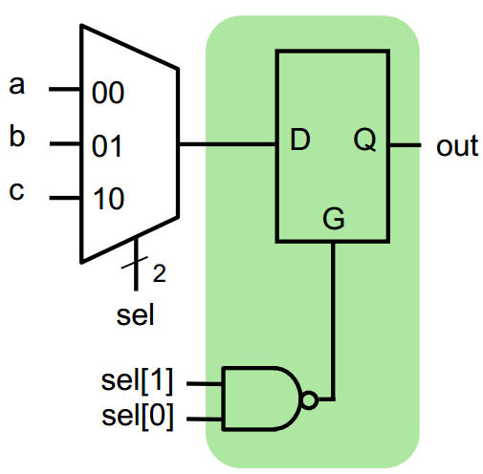
Unwanted Latch Generation
If you don’t assign every element that is required in an always block, every time that always block is executed, an unwanted latch is inferred for that element.
wire [1:0] sel;
reg out;
always @(*)
case (sel)
2’b00: out = a;
2’b01: out = b;
2’b10: out = c;
endcase

Slide 8
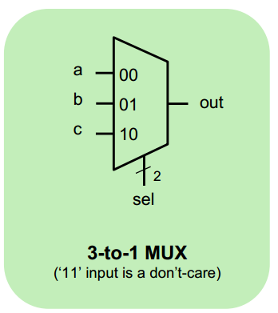
Avoiding Latch Generation
wire [1:0] sel;
reg out;
always @(*)
begin
out = 1’bx;
case (sel)
2’b00: out = a;
2’b01: out = b;
2’b10: out = c;
default: out = 1’bx;
endcase
end
Either of these lines is enough to avoid latch generation

Slide 9
Priority Encoder
module encoder(w,f,y);
input [3:0] w;
output reg [1:0]y;
output f;
assign f=|w;
always @(w)
casex(w)
'b1xxx: y=3;
'b01xx: y=2;
'b001x: y=1;
'b0001: y=0;
'b0000: y=x;
endcase
endmodule
W3 | W2 | W1 | W0 | Y1 | Y0 | f
0 | 0 | 0 | 0 | d | d | 0
0 | 0 | 0 | 1 | 0 | 0 | 1
0 | 0 | 1 | x | 0 | 1 | 1
0 | 1 | x | x | 1 | 0 | 1
1 | x | x | x | 1 | 1 | 1

Slide 10
BCD Adder
module BCD_adder (Cin, X, Y, S, Cout);
output reg [3:0] S;
output reg Cout;
input Cin;
input [3:0] X, Y;
reg [4:0] Z;
always @(*)
begin
Z= X + Y + Cin;
if (Z<10)
{Cout, S} = Z;
else
{Cout, S} = Z + 6;
end
endmodule
output Cout;
reg Cout;
always @(X, Y, Cin)

